Slide 1







DATA SCIENCE
PRESENTATION
HOUSEKEEPING
Presented By: Amanda Farghli, Fatoumata Drammeh, Khadiza Khanom, Maisha Islam, Alexandr Voronovich, Sharmin Zaman
December 17th, 2025

Slide 2

BACKGROUND INFO
Lack of Prior Knowledge
KEY PERFORMANCE INDICATORS
Needs and motivations
Rent takes up a lot of a person’s income. Typically at least 1/3rd but many pay more.
With such high rent costs, and an even higher entrance fee of owning a house, it can be so overwhelming for a person to even start to consider if buying is an option for them. That’s what we plan to solve
45% Renters who regret Renting
45%
Renters often think buying is not an option and buyers tend to buy, unaware of underlying costs and future problems. These issues stem from a lack of prior knowledge. A clear understanding of renting and buying costs can make all the difference.
8% of Buyers who regret Buying
8%

Slide 3
OUR MAIN
OBJECTIVES
1
2
3
What is the problem?
Who needs it?
Our Solution
With both rent and house prices rising, it’s unclear which is the better option. What factors are in play to make it the better option?
Any young-adult looking into a one-stop shop resource that will help them factor when would be the best time to buy or continue renting
A quick, fast, and simple information hub for a person to be able to discern whether renting or buying is better for their situation.

Slide 4






End-to-End Data Processing
Extract data through web scraping and API
Load into MySQL
Transform using Python

Slide 5
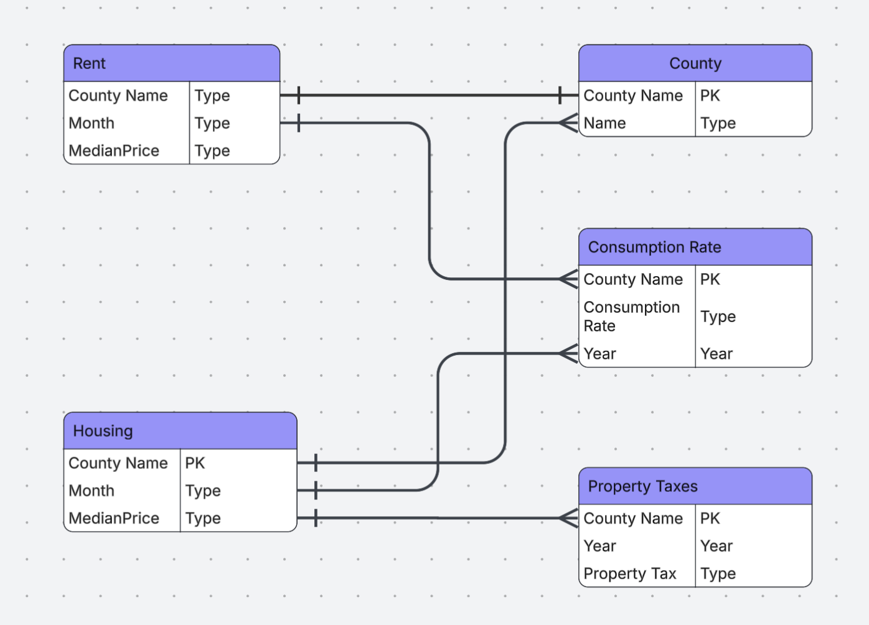
Data Model

Slide 6
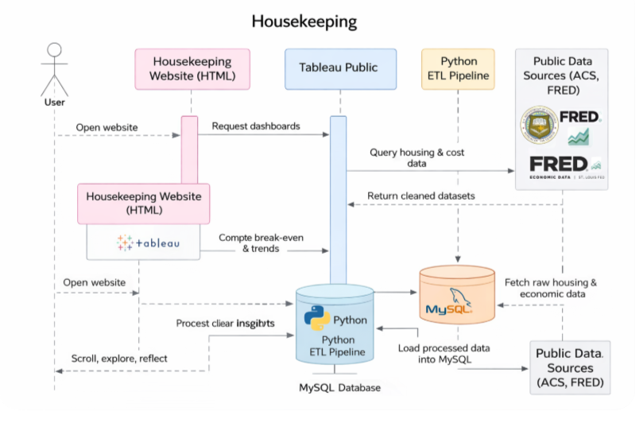
Sequence
Diagram

Slide 7
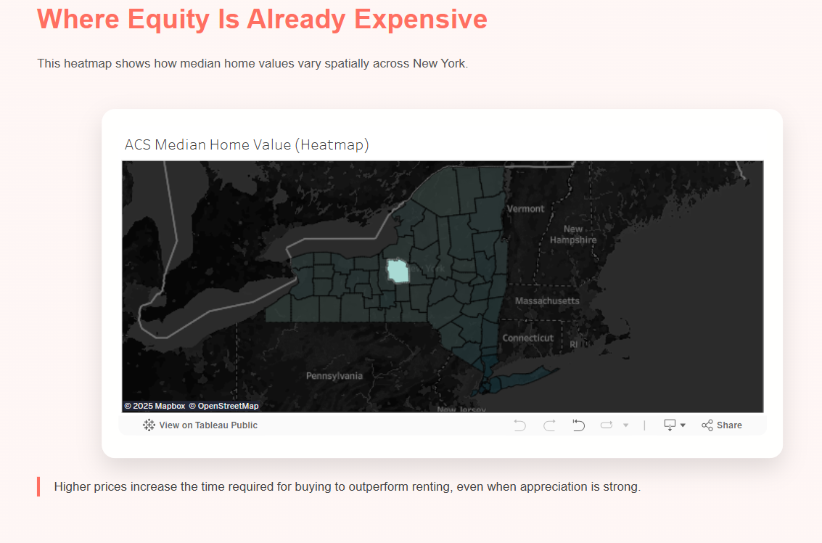
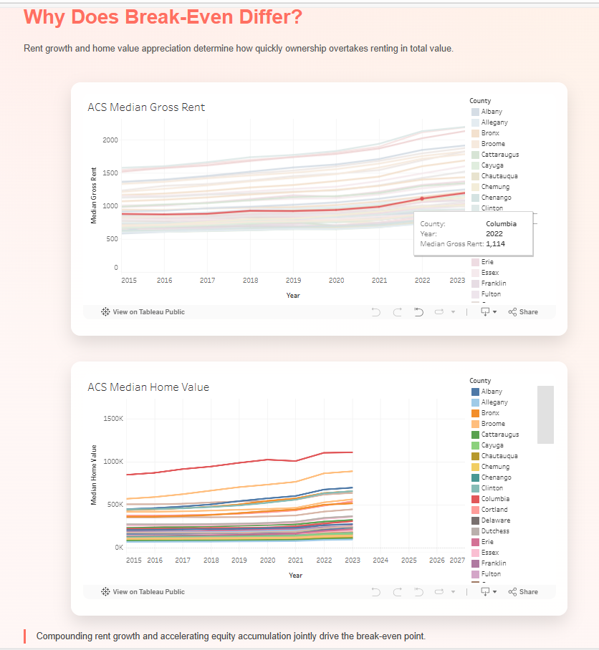
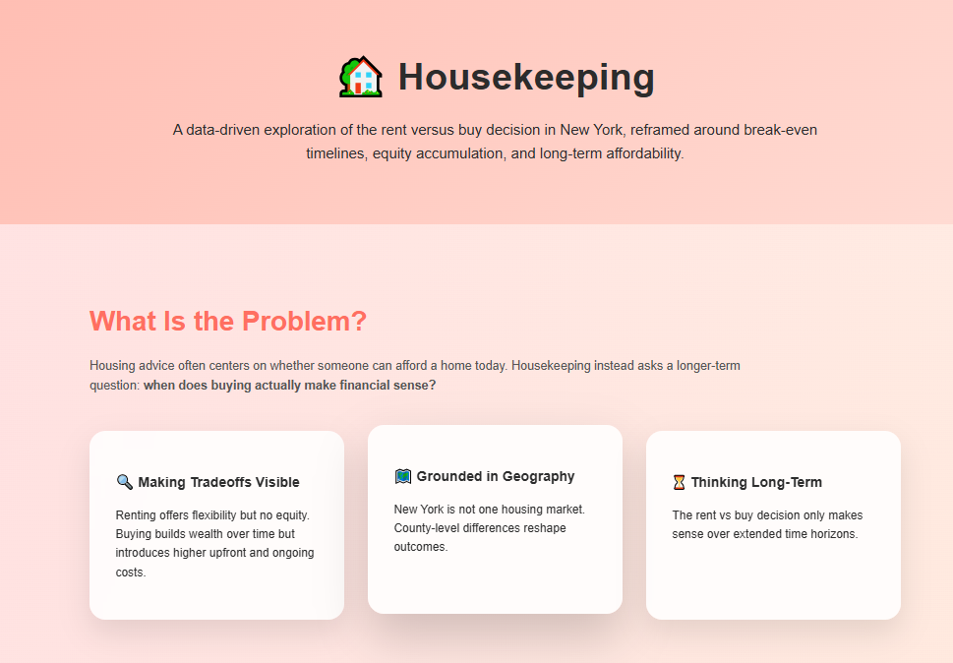
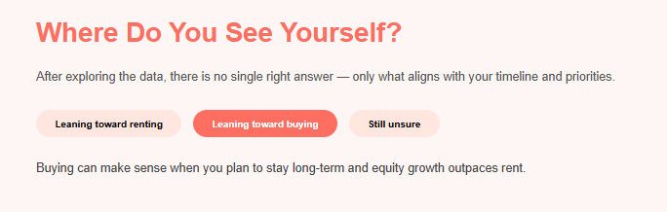
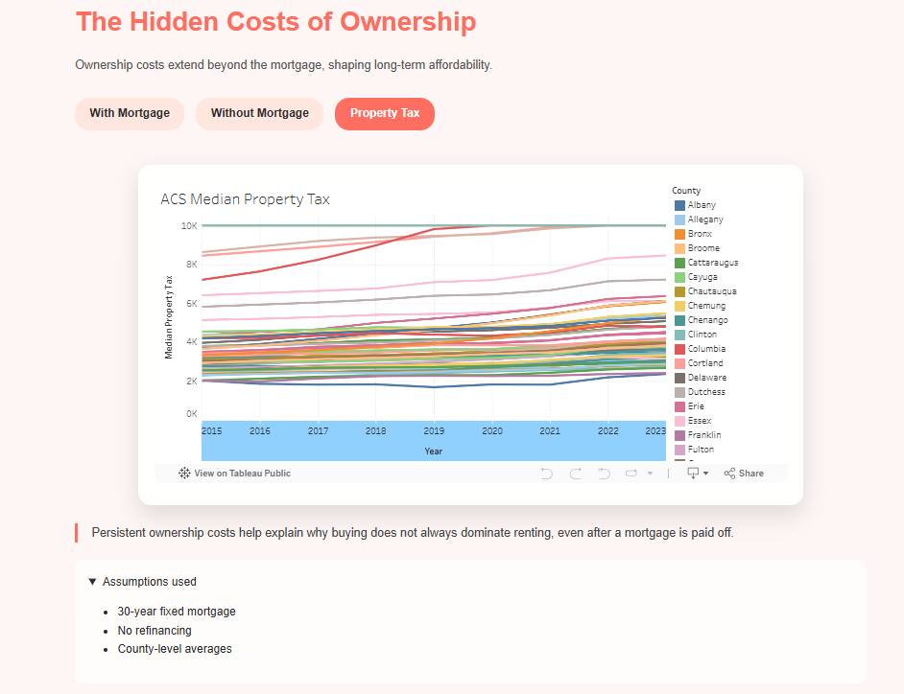
User Interface

Slide 8
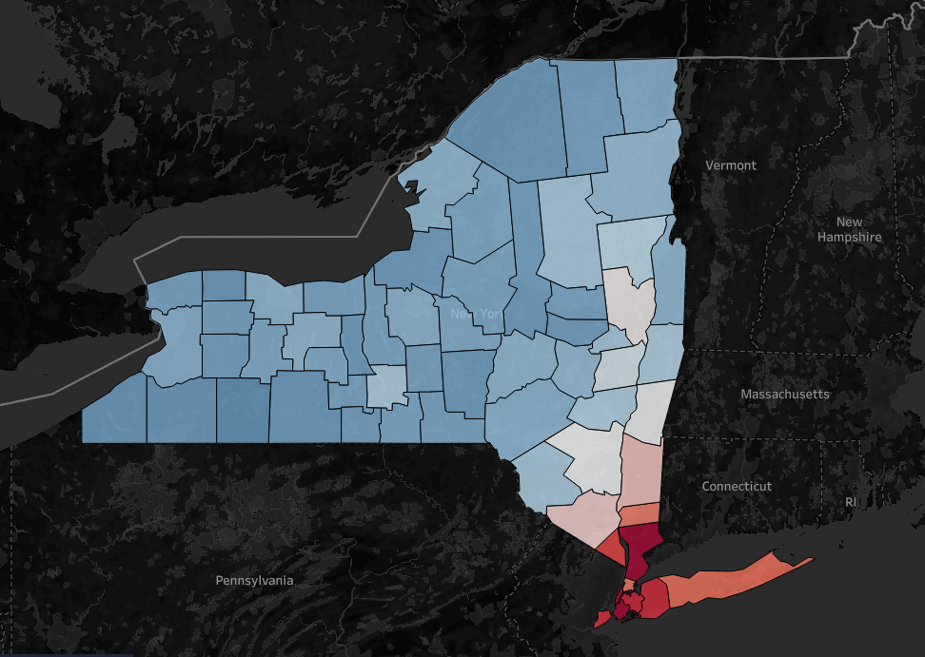
Visualizations & Predictions
The areas in blue are counties where the median house price are below our initial 250k savings.
While the counties in red are where the median is above 250k.
Our prediction is that buying a home will be better than renting in areas where our monthly costs are near even.

Slide 9
DEMO
Notes:
WHY PROPHET CREATES RANDOM DIPS IN FUTURE YEARS Prophet is designed to capture: Trends Seasonality Uncertainty It is NOT a perfect straight-line predictor. If your county’s historical data has even one slower year, Prophet will sometimes: flatten overcorrect or dip slightly This is completely normal behavior for time-series forecasting. BUT… If you want a purely increasing forecast (no dips ever), Prophet won’t do that by default. We must force Prophet to produce monotonic growth.

Slide 10
THANK
YOU!

